Slide 1


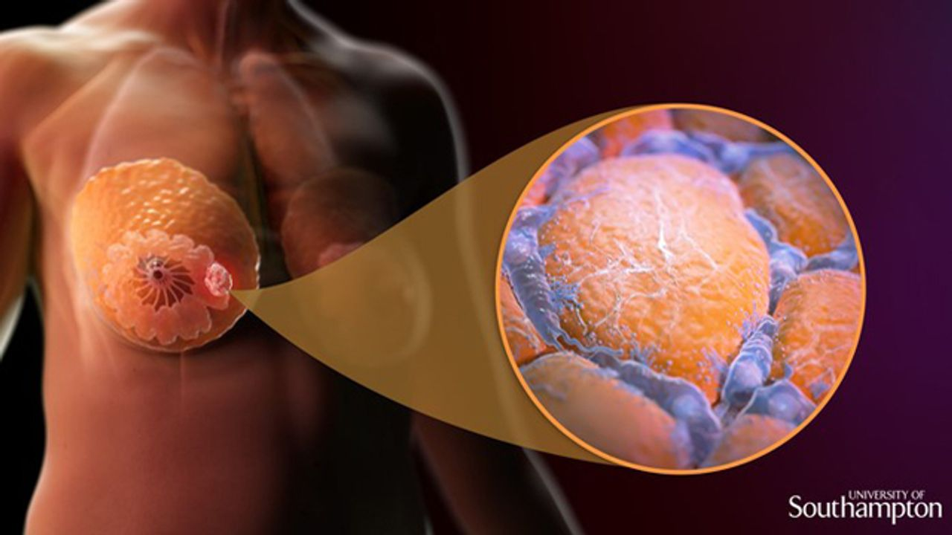
Breast cancer detection from histopathology images using deep learning techniques
DONE BY:
ABIRAMI SHREE P
UNDER THE GUIDANCE OF:
Prof.CHIRANJEEVI N

Slide 2

Table of Contents
1
INTRODUCTION
4
METHODOLOGY
2
LITERATURE REVIEW
5
RESULTS & CONCLUSION
3
AIM & OBJECTIVE
6
REFERENCES
2

Slide 3
INTRODUCTION
Breast Cancer :
4 common types of breast cancer are ductal carcinoma in situ, invasive ductal carcinoma, inflammatory breast cancer, and metastatic breast cancer. (5)
2nd leading cause of cancer related deaths.(3)
3

Slide 4
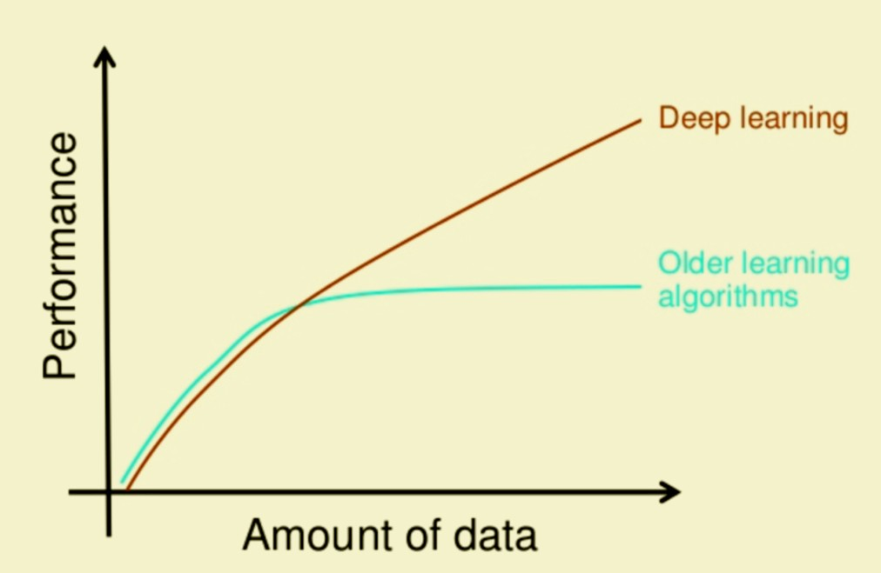
DEEP LEARNING TECHNIQUE :
Deep Learning is a subfield of machine learning concerned with algorithms inspired by the structure and function of the brain called artificial neural networks.
More time to train, but less time to compute.
More accuracy, flexibility (4)
4

Slide 5
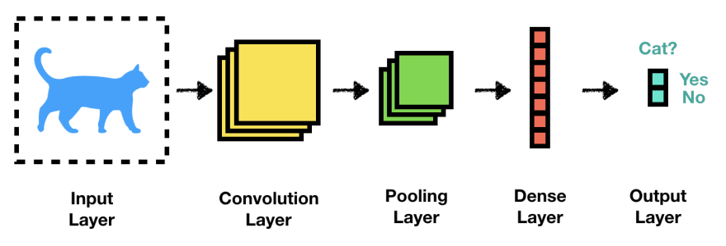
CNN – Convolutional Neural networks :
CNN is a type of ARTIFICIAL NEURAL NETWORK that are specially designed for image recognition and classification (specially designed to process pixel data).
It has 3 layers namely : input/ hidden/ output layers.(8)
5

Slide 6
ResNet 18 :
Explored in 2017 - Kaiming He.
It is a 72-layer CNN architecture that is 18 layers deep.
Uniqueness - overcame the vanishing gradient problem.
Greater efficiency with increase in the dataset being used for training.(6)
ReLU – Rectified Linear Unit
(key factor to overcome the vanishing gradient/ its key feature is that it doesn’t allow the activation of all the neurons at the same time ) (7)
6

Slide 7
REVIEW OF LITERATURE
S.NO | TITLE & Author | DATA | METHODOLOGY | AUTHOR & YEAR
1 | Deep learning based liver cancer detection using watershed transform and Gaussian mixture model techniques (1) | 225 - CT images of liver with cancer | Watershed transform & Gaussian mixture model-(Classification of HCC, HEM & MET) | Amita Das et al., -2019
2 | AI – Driven novel approach for breast cancer screening and prediction using cascaded fully convolutional neural network (2) | 1331 - MRI images of abdomen | Geodesic active contour analysis & Cascaded fully convolutional neural network - tumour detection, lesions | Piyush Kumar, Mohammed Zakaria, Hussar Taazi and Basant Tiwari - 2022
7

Slide 8
AIM :
To detect the presence of cancer cells if any, from the provided histopathology images of human breast tissue using deep learning model.
OBJECTIVES :
Classify - a histopathology image to detect the presence of cancer.
Formulate – a deep neural network model for the detection of normal & abnormal breast cells.
Evaluate - the accuracy of the model & report the metrics.
8

Slide 9
Methodology :
Testing
Training
Data augmentation
Pre-processing
Pre-processing
Segmentation
Segmentation
TESTING
TRAINING
Feature extraction & selection
Feature extraction & selection
Trained template
Tested
9

Slide 10
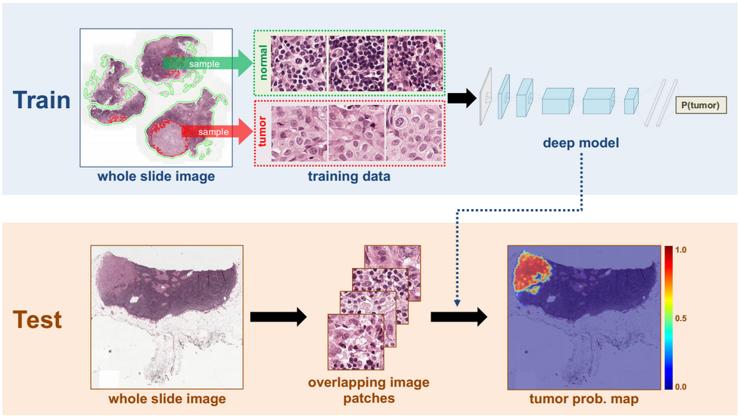
In brief ……
(12)
10

Slide 11
RESULTS & CONCLUSION :
DATASET SUMMARY
OVERALL – 2,77,524
TRAINING – 1,93,000
DEVELOPING – 40,000
TESTING – 44,524 (21)
PRE-TRAINED DATA
0 – HEALTHY
1 – CANCER
11

Slide 12
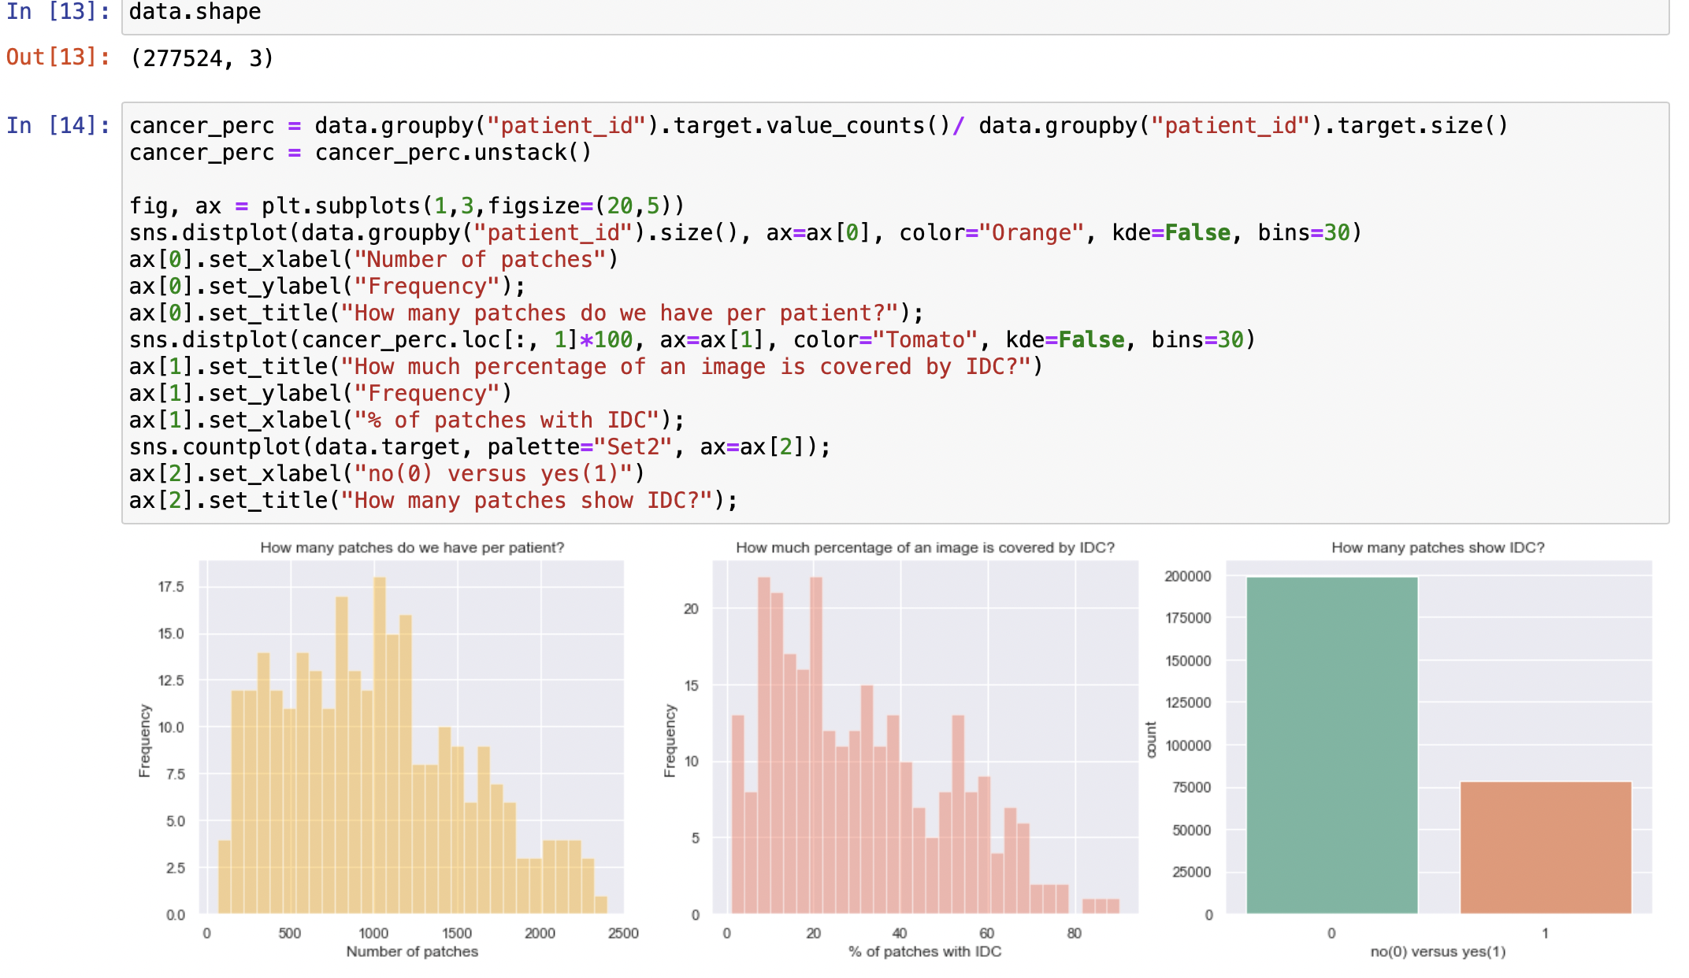
12

Slide 13
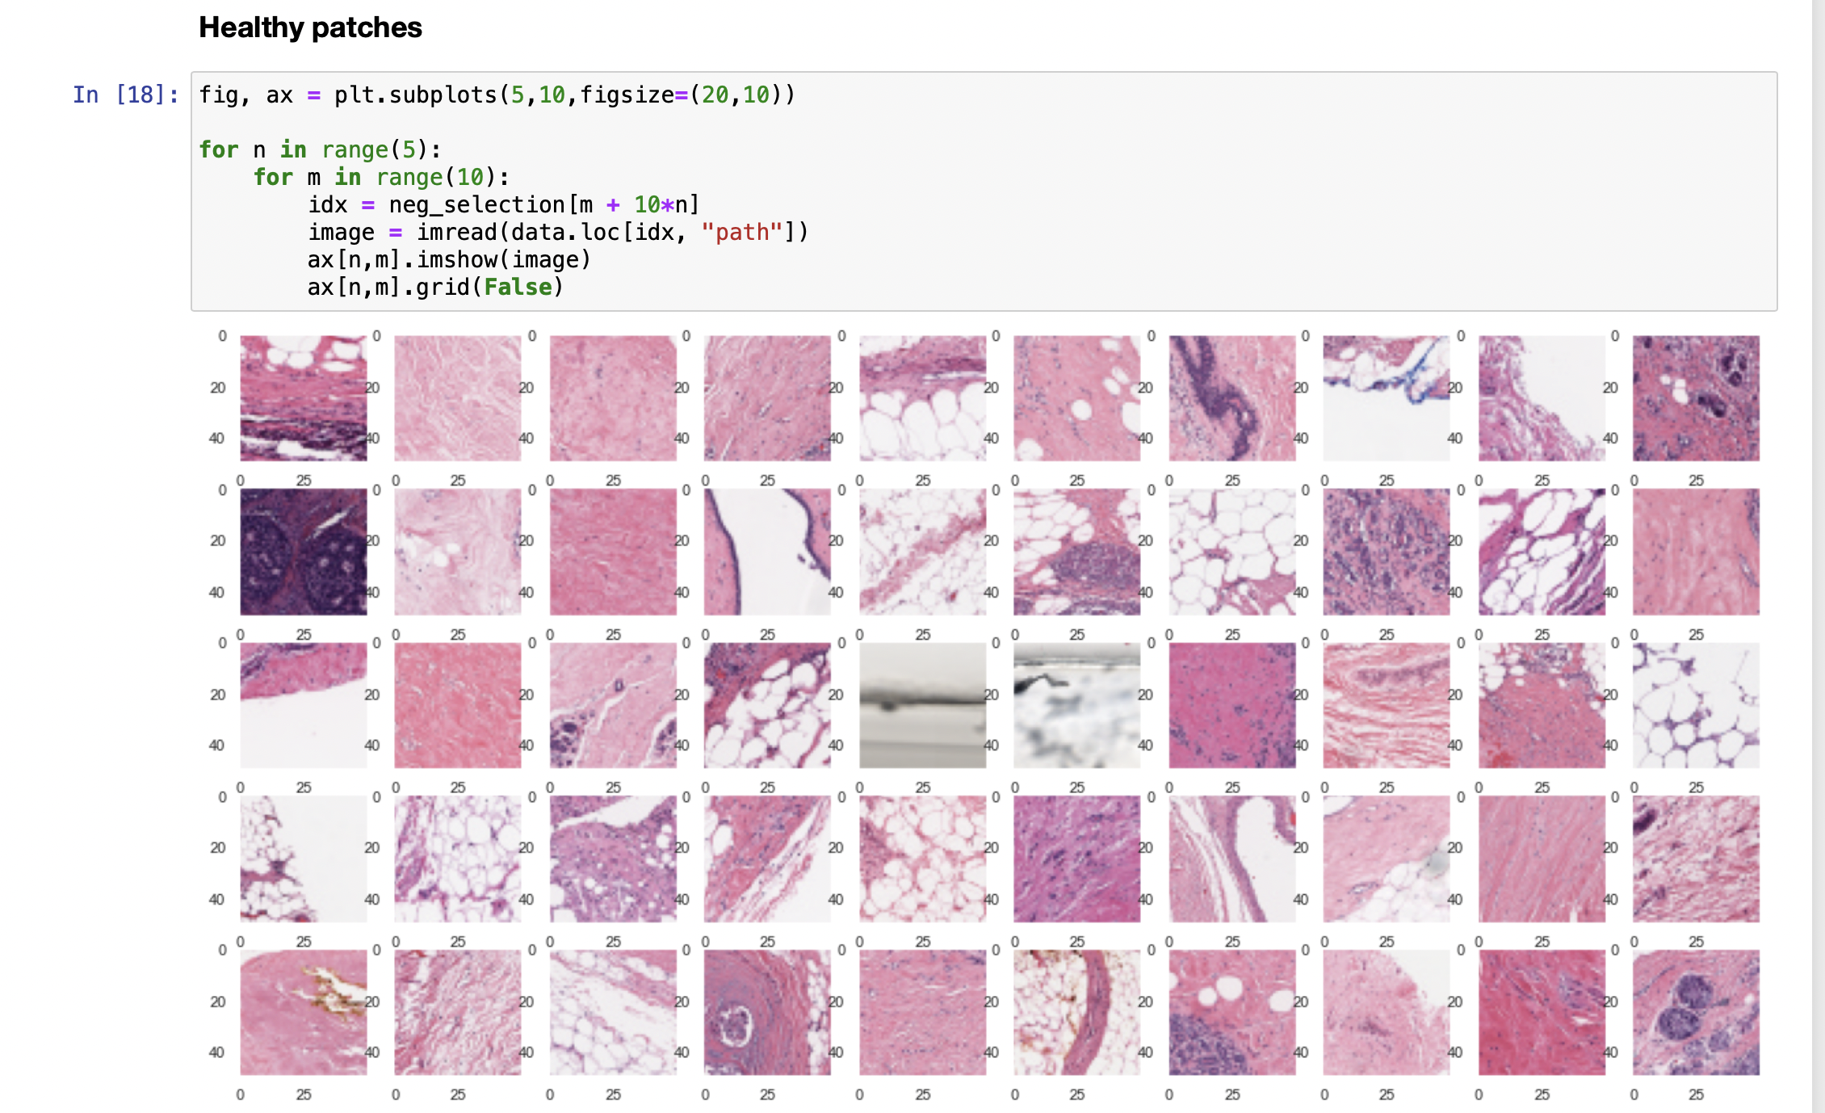
13

Slide 14
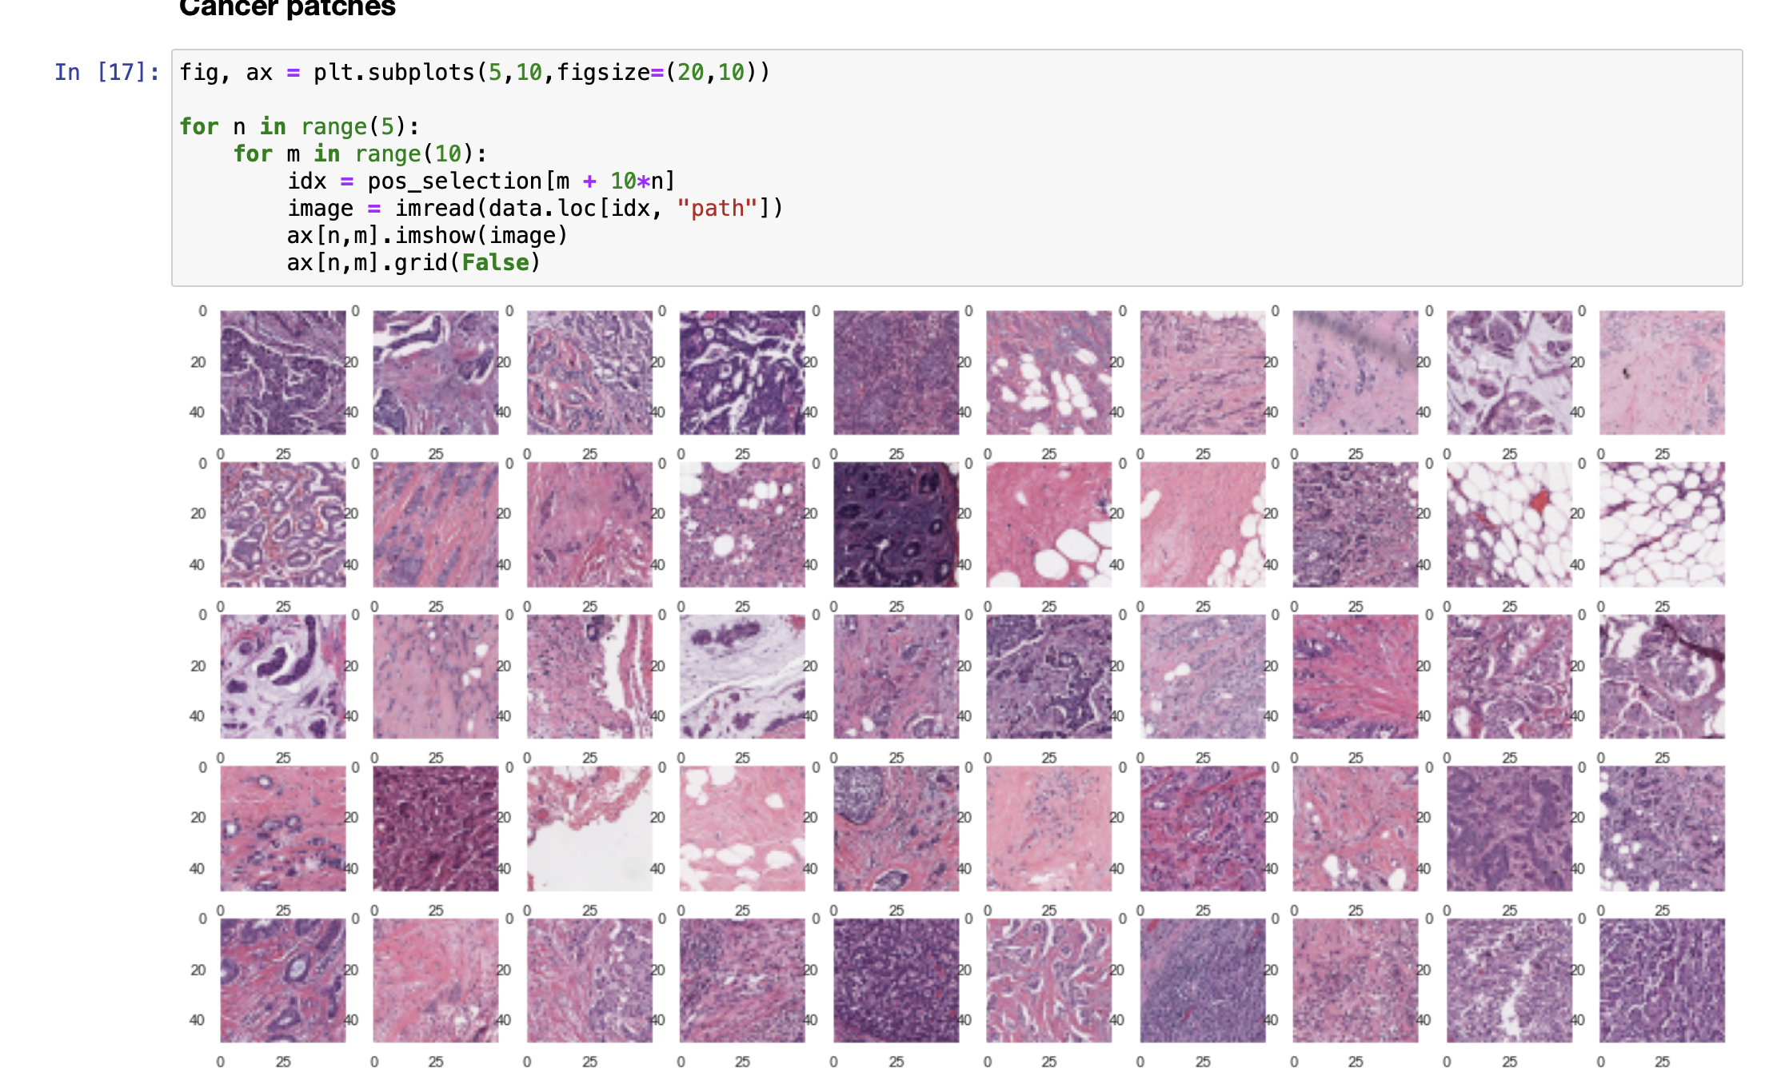
14

Slide 15
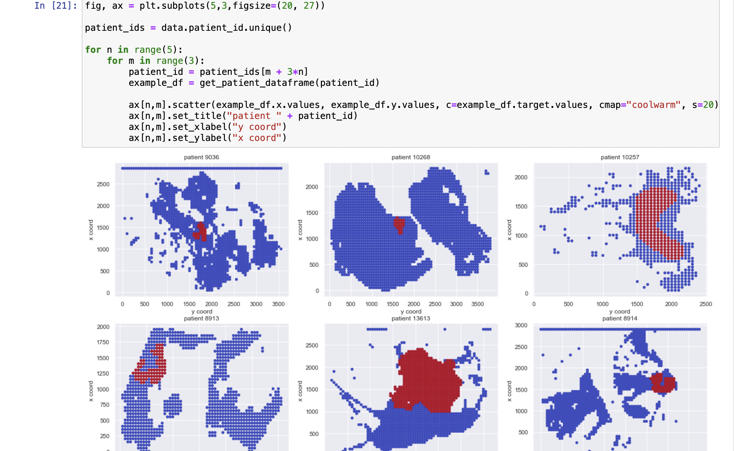
15

Slide 16
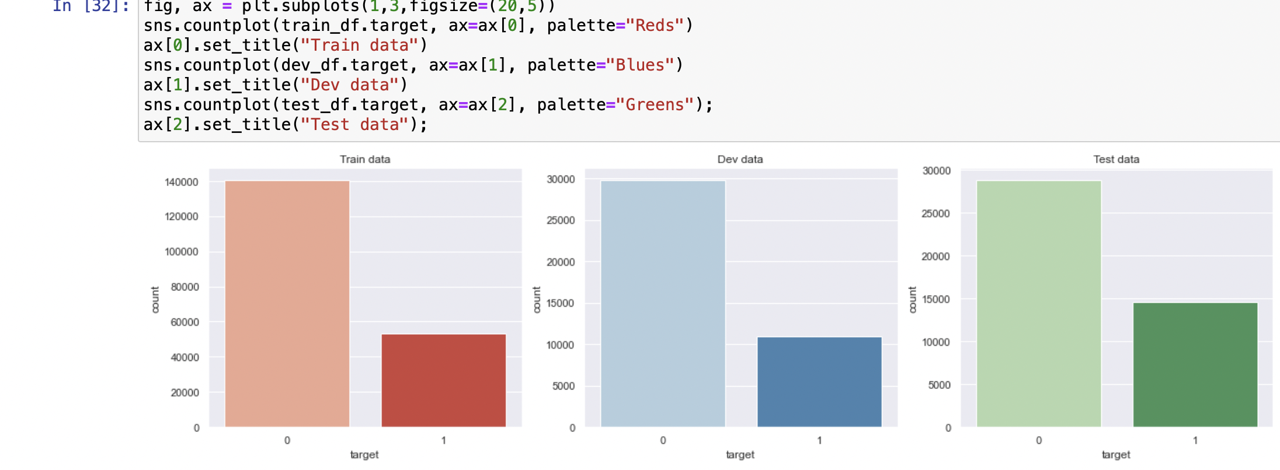
16

Slide 17
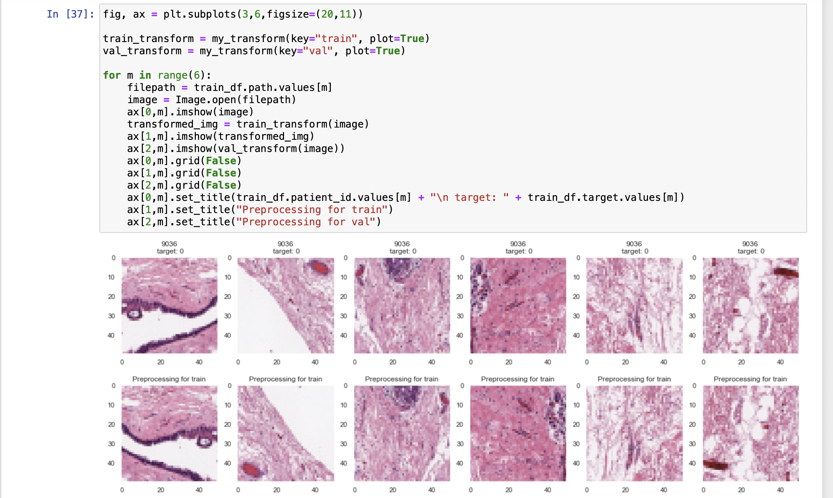
17

Slide 18
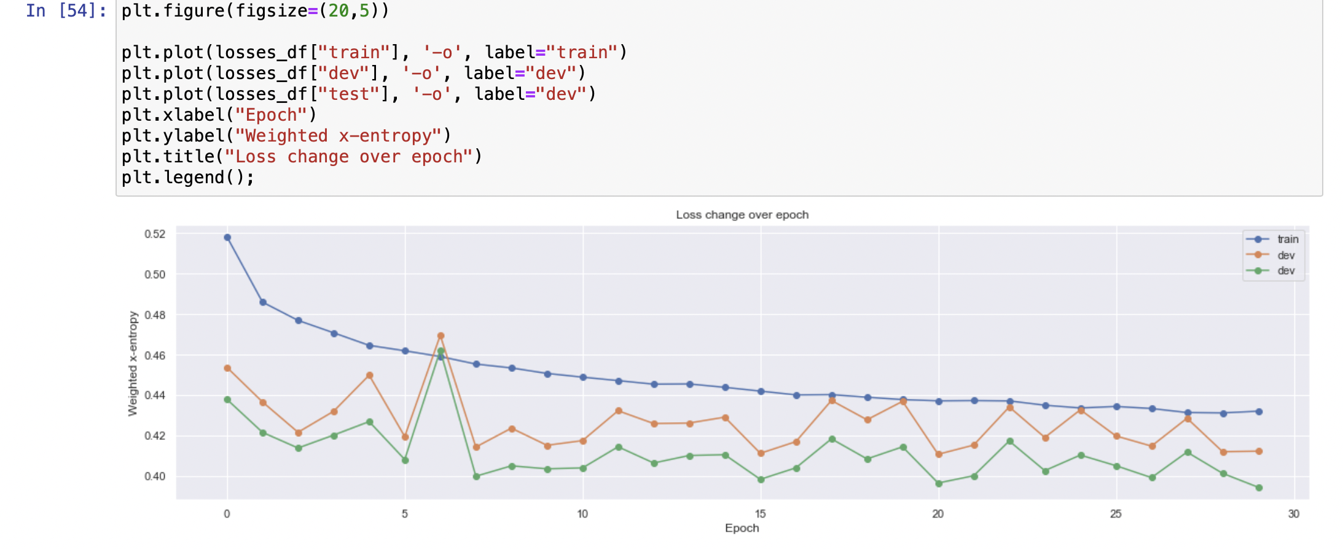
18

Slide 19
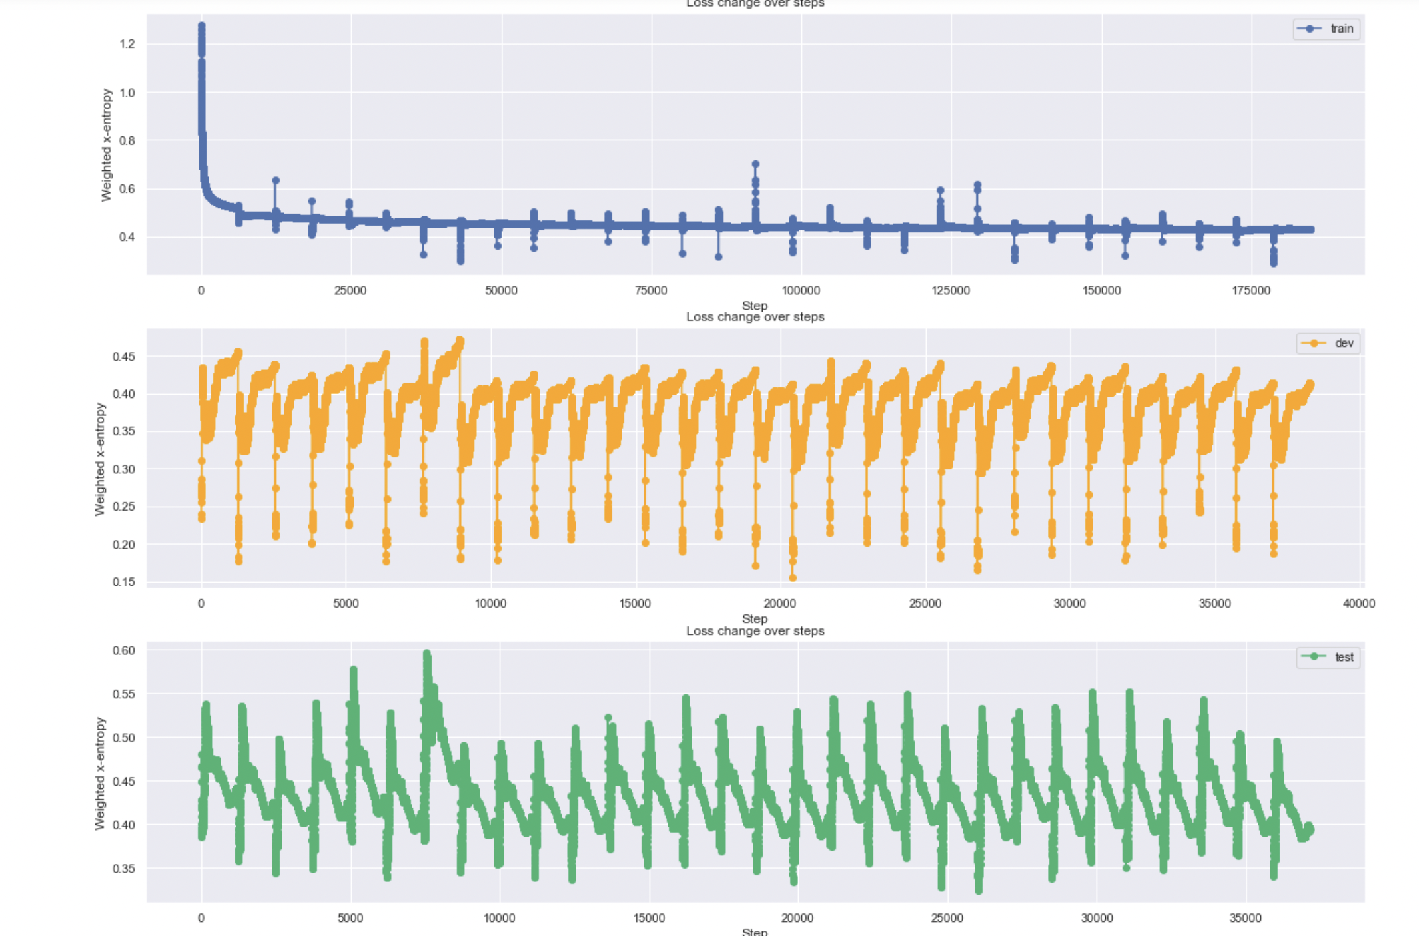
19

Slide 20
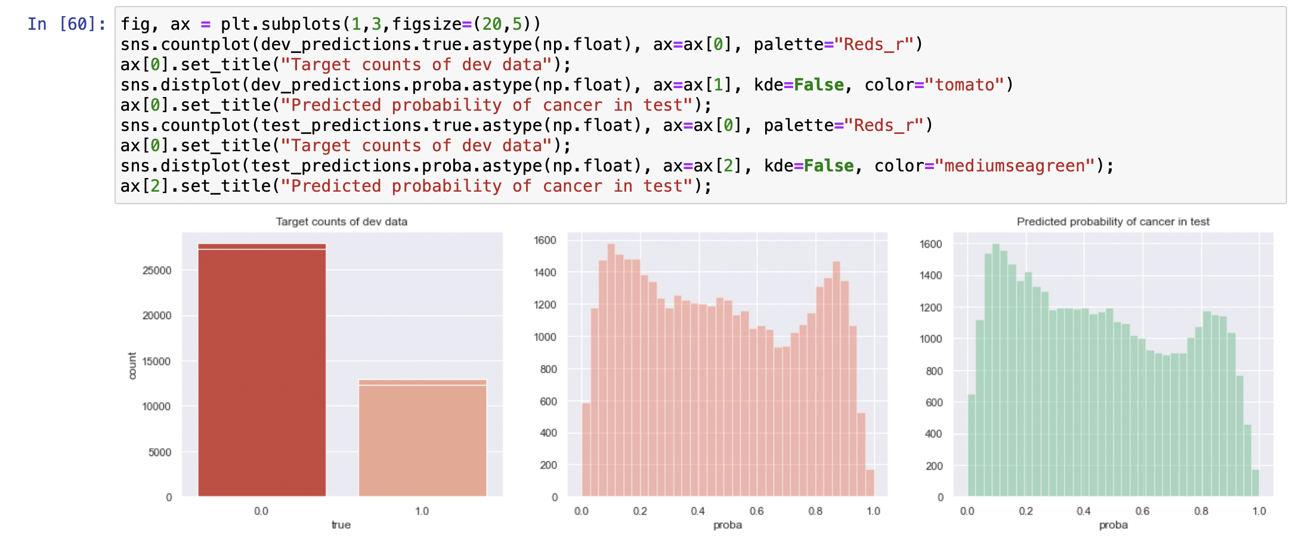
20

Slide 21
>0.5 - No discrimination
0.7-0.8 - Acceptable
0.8-0.9 - Excellent
>0.9 - Outstanding
Model accuracy: 0.99 AUC
Source: ROC curve (Receiver Operating Characteristic curve)
AUC (Area Under the Curve)
21

Slide 22
CONCLUSION:
Thereby implementing DL - (Deep Learning) models for the diagnosis purpose in the clinical practice using image based data will fetch an upper hand in the domain of both diagnosis as well as prevention of diseases to further proliferate.

Slide 23
References:
1. Das A, Acharya UR, Panda SS, Sabut S. Deep learning based liver cancer detection using watershed transform and Gaussian mixture model techniques. Cogn Syst Res. 2019;54(December):165–75.
2. Shukla PK, Zakariah M, Hatamleh WA, Tarazi H, Tiwari B. AI-DRIVEN Novel Approach for Liver Cancer Screening and Prediction Using Cascaded Fully Convolutional Neural Network. J Healthc Eng. 2022;2022.
Web references
3. https://www.pcf.org/about-breast-cancer/diagnosis-staging-breast-cancer/breast-cancer-/.
4. https://oncohemakey.com/anatomy-and-pathology-of-breast-cancer/.
5. https://breastcancernewstoday.com/breast-cancer-overview/.
6. https://www.cancer.net/cancer-types/breast-cancer/risk-factors-and- prevention.
7. https://www.cancer.net/cancer-types/breast-cancer/symptoms-and-signs.
22

Slide 24
8. https://www.slideshare.net/FarazaJaved/breast-cancer-79088572.
9. https://www.ncbi.nlm.nih.gov/books/NBK65915/.
10. https://www.sas.com/en_in/insights/analytics/machine-learning.html.
11. https://www.kaggle.com/datasets/sebastianriechert/lbreastcancer-diagnosis.
23

Slide 25
Thank you……

